Slide 1


Slide 2
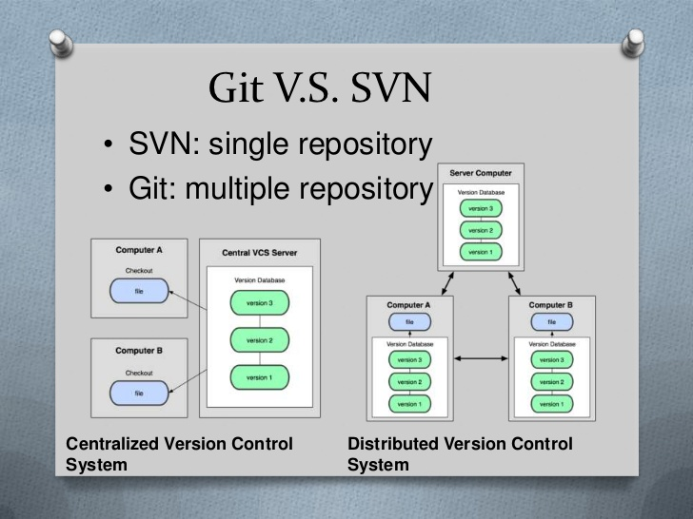

Slide 3
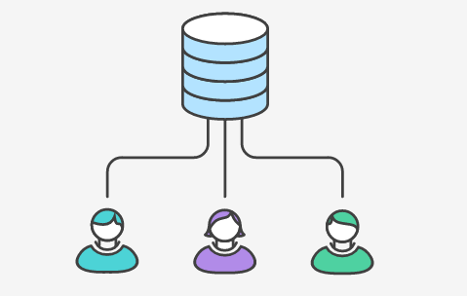
Centralized Workflow

Slide 4
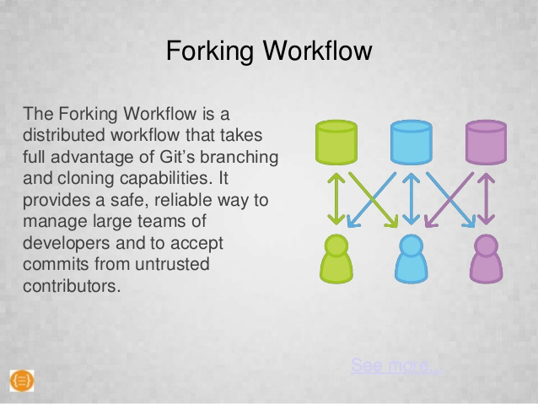
GIT (Forking Workflow)

Slide 5
Different ways of using Git
Command Line
IDE (Integrated Development Environments) like: Netbeans, Eclipse.
GIT GUI

Slide 6
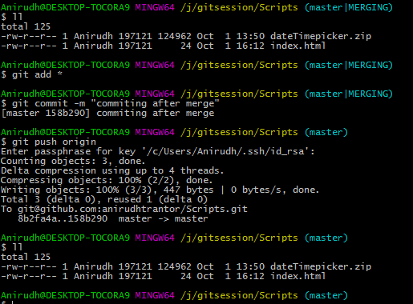
Command Line

Slide 7
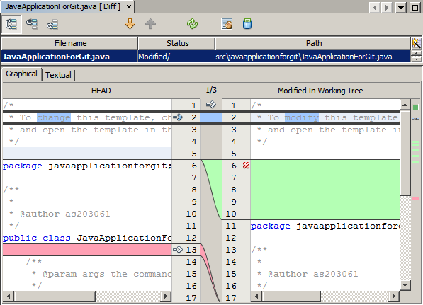
IDE (Makes version control easy)

Slide 8
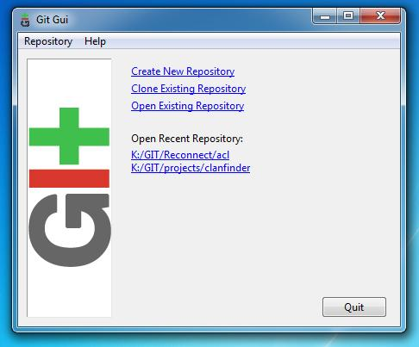
GIT GUI

Slide 9
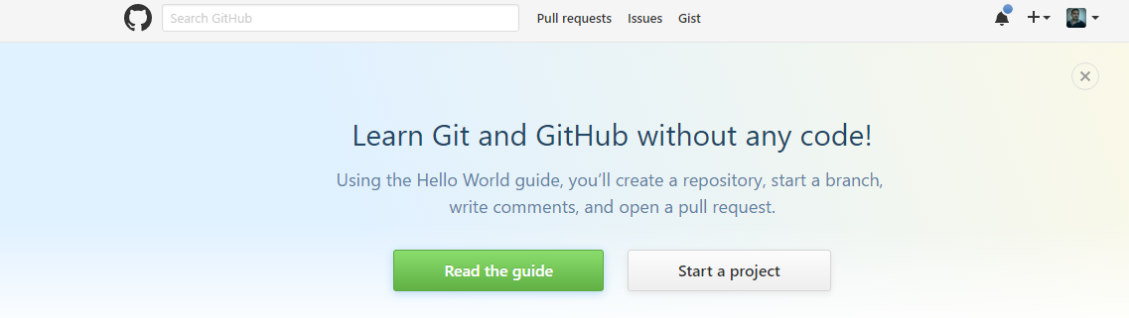
Working with GIT - using Github

Slide 10
Git Forking Workflow
Fork a GitHub repository.
Clone the forked repository to your local system.
Add a Git remote for the original repository.
Create a feature branch in which to place your changes.
Make your changes to the new branch.
Commit the changes to the branch.
Push the branch to GitHub.
Open a pull request from the new branch to the original repo.
Clean up after your pull request is merged.

Slide 11
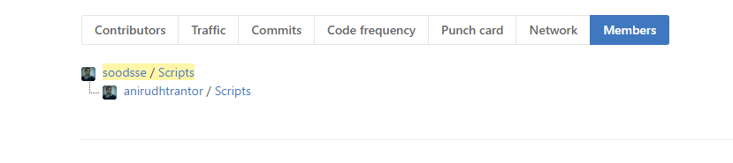
Forking A Git Repository
First step, is to fork repository on which you want to contribute. Like as a developer, designers or Managers or what ever role we are in. We can contribute to many Open Source Communities by Forking.
Forking is best workflow when peoples are working remotely and in big teams.

Slide 12
Forking a GitHub Repository
Forking it is basically making a copy of the repository, but with a link back to the original.
Make sure you’re logged into GitHub with your account.
Find the GitHub repository with which you’d like to work.
Click the Fork button on the upper right-hand side of the repository’s page.

Slide 13
Git Steps
Making a Local Clone
// Before that need to create SSh account or can use https URL.
git clone git@github.com:anirudhtrantor/Scripts.git
you’d replace the URL after git clone with the appropriate HTTPS clone URL for your forked project repository.
Git will copy down the repository, both contents and commit history, to your system
Git remote called origin that points back to the forked repository in your GitHub account.

Slide 14
Adding Remote
Git already added a Git remote named origin to the clone of the Git repository on your system.
This will allow you to push changes back up to the forked repository in your GitHub account using git commit (to add commits locally) and git push.
To use the “fork and branch” workflow you’ll need to add a Git remote pointing back to the original repository. Below is the command:
git remote add upstream https://github.com/soodsse/Scripts.git

Slide 15
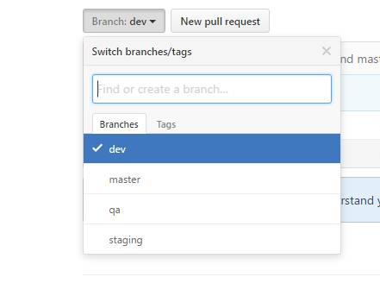
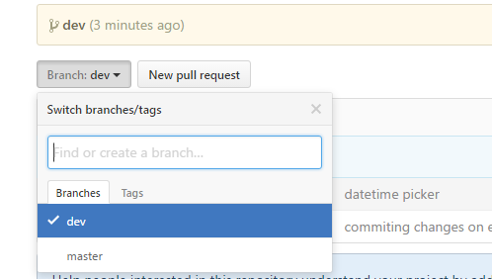
Comparison on Repo.
Main Repo Forking Repo(Dev)

Slide 16
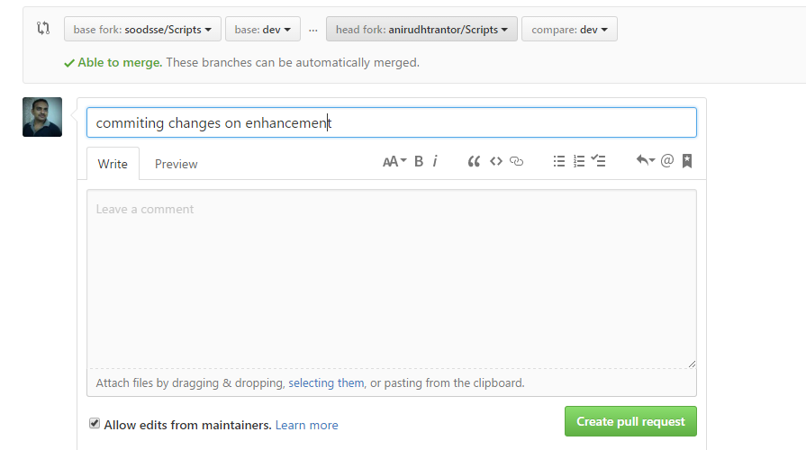
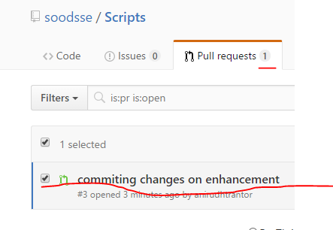
Pull request

Slide 17
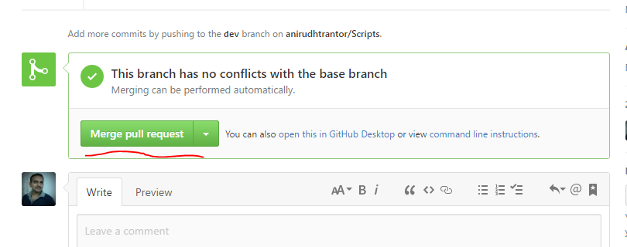
Merge Pull Request

Slide 18
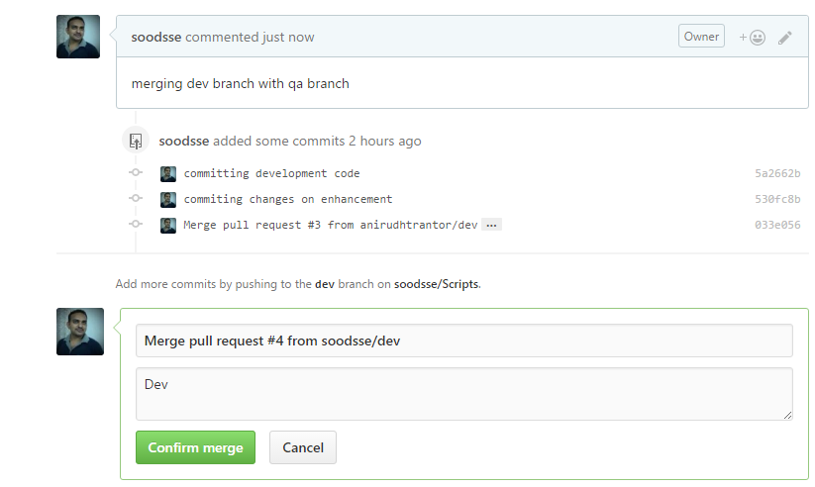
Confirm Merge

Slide 19
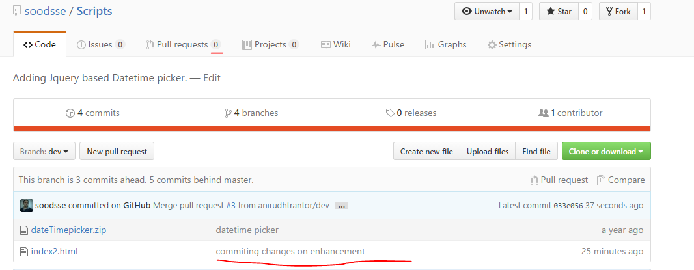
Changes Merged in Dev Branch

Slide 20
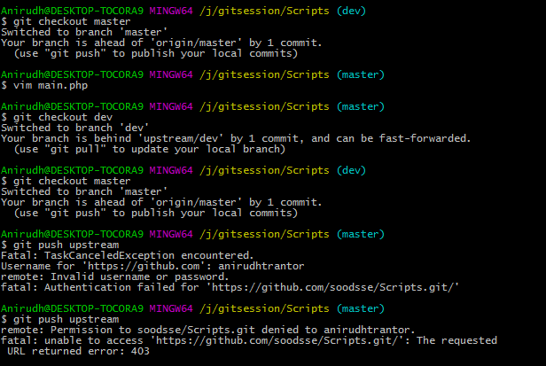
Avoiding committing on Master Branch

Slide 21
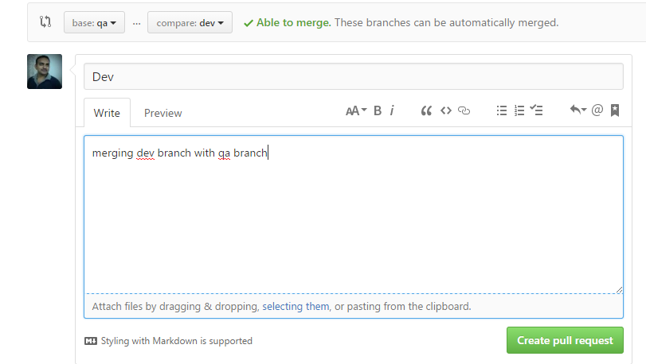
Merge Branches Dev to QA

Slide 22
Thank you
Anirudh Sood
You can reach me at:
anirudh.sood@trantorinc.com
Mob: 7508946708

